Slide 1

AMERICAN INTERNATIONAL UNIVERSITY – BANGLADESH Malicious Link Detection Using Web Analytics Supervised by: Dr. Md. Sohidul Islam Presented by:
Name | ID
Islam, Nuhan | 18-37898-2
Fahim, Abu Talha | 18-38125-2
Faahim, Mohammad Zaahirul Islam | 18-38163-2
Mazumder, Mohammad Sakib Islam | 19-39290-1
Department of Computer Science
Faculty of Science and Information Technology
American International University – Bangladesh
May, 2022

Slide 2
Table of Contents
Terms Used
Introduction
Problem Statement
Objective
Proposed Solution
Literature Review
Background Study
Malicious Link Detection Model
Web Analytics:
Bounce Rate
Page Per Visit
Time On Site
Total Visits
Sample Output:
Secure Link
Malicious Link
Result & Discussion
Limitations of the System
Future Works
References

Slide 3
Terms Used
URL: Universal Resource Link
HTTPS: Hyper Text Transfer Protocol Secured
DNS: Domain Name System
API: Application Programming Interface

Slide 4
Introduction
Web browsing is the most widespread use of technology
Advancement in both good and bad use of technology
Exploitation mechanisms are easy to access
Long history of victimized users
Top priority of safe browsing

Slide 5
Problem Statement
Inexperienced netizens are usually victims
Online scams
Theft of bank accounts and user accounts
Malware attack and botnets
Stealing user data via inputting credentials

Slide 6
Objective
Check malicious links before accessing
Easy to use interface
Accessibility across platforms
Provide a validation for links

Slide 7
Proposed Solution
Web based application
Backend analytics check via Application Programming Interface (API)
Fast response

Slide 8
Literature Review
Idea derived from phishing links
Malicious links have certain patterns for recognition
Malware injection, device tampering and data compromising are common issues
Cybercrime has spiked up with the advent of modern technology
Target audience are usually inexperienced

Slide 9
Background Study
Web based applications are feasible for cross platform use
Users can check for safety of a website prior to visiting
Real time analysis helps to get accurate data
Margin of error is very low
Independent of updates or devices

Slide 10
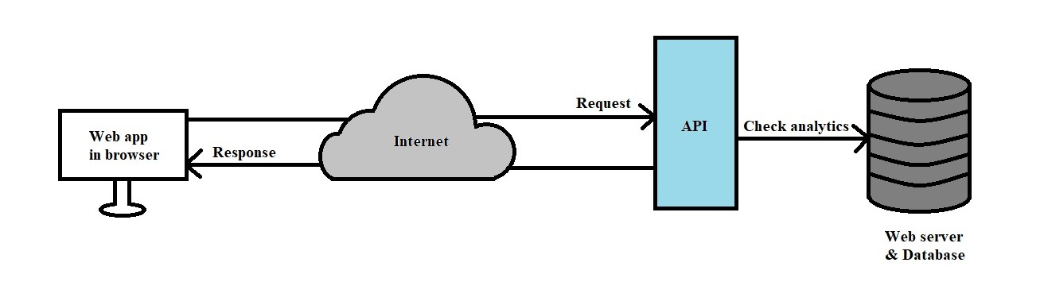
Malicious Link Detection Model

Slide 11
Web Analytics: Bounce Rate
Level of visits that have just a single site visit
Bounce sessions are generally viewed as disappointments by advertisers and web examiners
Appropriate range is greater than or equal to 0.15 and less than or equal to 20

Slide 12
Web Analytics: Page Per Visit
Pages per visit is an expansive proportion of how convincing visitors observe the substance on a site and how well it is sorted out for route
Pages Per Visit by a user is taken ranging from greater than or equal to 1 and less than or equal to 15 for a valid website
A low number of pages per visit might propose that either the content is missing or the capacity to explore effectively between content is hampered by the site's general plan/association

Slide 13
Web Analytics: Time On Site
It is the report that gives information on how much time (in minutes or seconds) visitors have spent on a site
Ideally time spent surfing on the website is taken greater than or equal to 30 and less than or equal to 800

Slide 14
Web Analytics: Total Visits
It is an estimation of site traffic and site visitors
For a website to be deemed safe, Total Visits has to be greater than or equal to 999
Less traffic on a website usually signifies that the site is invalid or contains malicious content

Slide 15
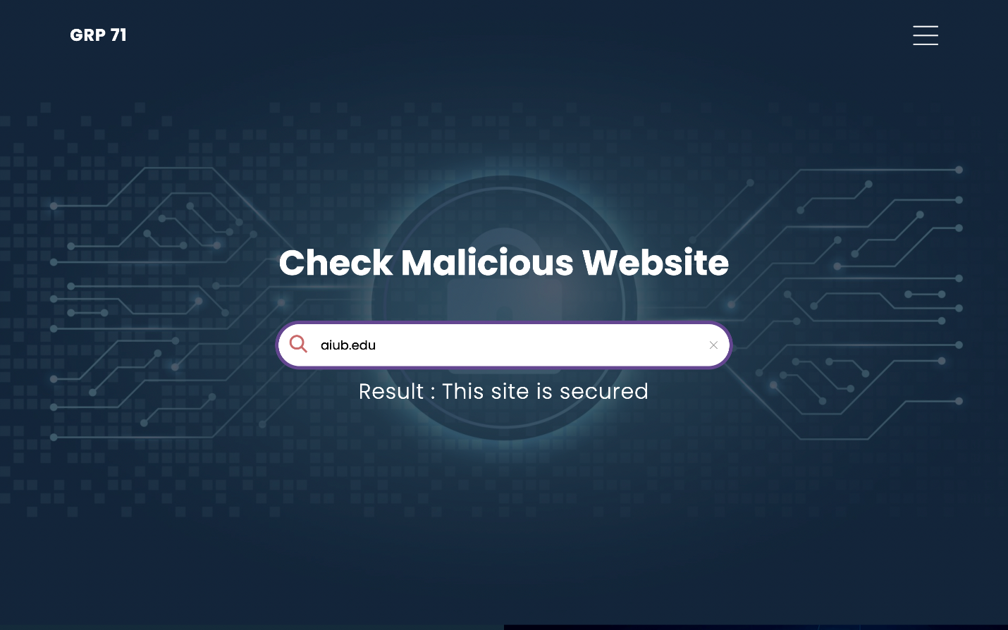
Sample Output: Secure Link

Slide 16
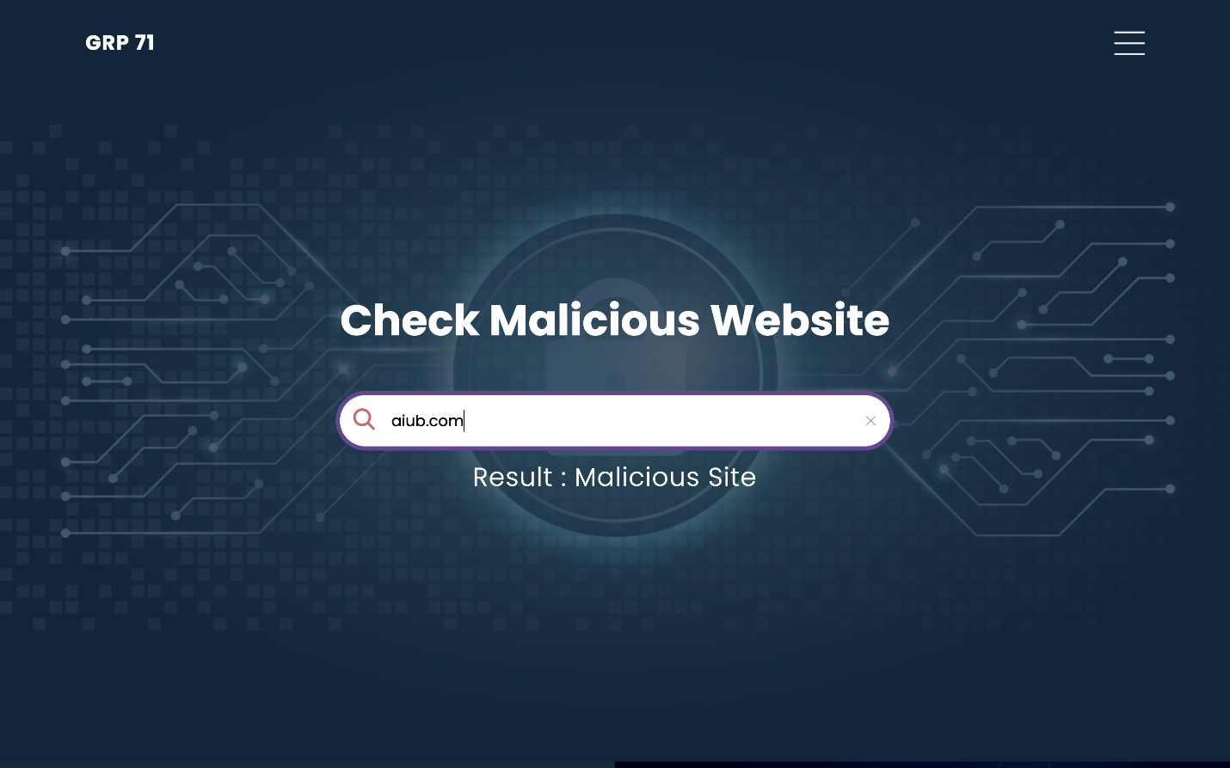
Sample Output: Malicious Link

Slide 17
Result & Discussion
Wide scopes of development
Primary stages of internet security can be achieved
Beneficial to both inexperienced and experienced users
Analytical tests are overlooked towards complex solutions but we tried to prove that this is not the case

Slide 18
Limitations of the System
Primary stages of development
Unintegrated and independent platform
Machine learning and AI can provide in depth analysis

Slide 19
Future Work
Further research and development
Integrating Machine Learning
Implementing advanced solutions such as Firewall, Firmware Security and Network Security
Pseudo Malware Detection Systems

Slide 20
References
[1] Bilge, L., Kirda, E., Kruegel, C. and Balduzzi, M., 2011, February. Exposure: Finding malicious domains using passive DNS analysis. In Ndss (pp. 1-17).
[2] Crocker, Steve, David Dagon, Dan Kaminsky, DKH Danny McPherson, and Paul Vixie. "Security and other technical concerns raised by the DNS filtering requirements in the PROTECT IP Bill." White Paper 6 (2011): 1.
[3] Dolmans, Ralph. "Preventing DNS Amplification Attacks using white-and greylisting." Unpublished dissertation in partial fulfillment of the requirements for the degree of Master of System and Network Engineering, University of Amsterdam, Amsterdam, Netherlands (2013).
[4] Khonji, Mahmoud, Youssef Iraqi, and Andrew Jones. "Phishing detection: a literature survey." IEEE Communications Surveys & Tutorials 15, no. 4 (2013): 2091-2121.
[5] Dhamija, Rachna, J. Doug Tygar, and Marti Hearst. "Why phishing works." In Proceedings of the SIGCHI conference on Human Factors in computing systems, pp. 581-590. 2006.

Slide 21
References
[6] Tandale, Kiran D., and Sunil N. Pawar. "Different types of phishing attacks and detection techniques: A review." In 2020 International Conference on Smart Innovations in Design, Environment, Management, Planning and Computing (ICSIDEMPC), pp. 295-299. IEEE, 2020.
[7] Chiew, Kang Leng, Kelvin Sheng Chek Yong, and Choon Lin Tan. "A survey of phishing attacks: Their types, vectors and technical approaches." Expert Systems with Applications 106 (2018): 1-20.
[8] Gupta, Surbhi, Abhishek Singhal, and Akanksha Kapoor. "A literature survey on social engineering attacks: Phishing attack." In 2016 international conference on computing, communication and automation (ICCCA), pp. 537-540. IEEE, 2016.
[9] Ofoeda, Joshua, Richard Boateng, and John Effah. "Application programming interface (API) research: A review of the past to inform the future." International Journal of Enterprise Information Systems (IJEIS) 15, no. 3 (2019): 76-95.
[10] Kamerer, D., 2020. Reconsidering bounce rate in web analytics. Journal of Digital & Social Media Marketing, 8(1), pp.58-67.

Slide 22
Thank you for your kind attention

